Slide 1
An Economic Analysis of the Impact of COVID-19 on Hong Kong Economy
Economics
Personal, Social and Humanities Education Section
Curriculum Development Institute, Education Bureau
May 2020

Slide 2
Foreword
This resource aims at introducing how economic concepts can be applied to analyze daily-life issues for teachers’ and students’ reference. Due to the rapid development of COVID-19 pandemic, its impacts on economy (especially on macroeconomics) are widespread and ever-changing. As such, it is important to include timely information when using this resource. Students may also pay attention to the development of this issue and make analysis by using the latest available data.

Slide 3
Part I: Macroeconomics
How does the pandemic affect Hong Kong economy?
How does the government respond to the economic difficulties through fiscal policy?

Slide 4
How does the epidemic affect Hong Kong economy?
To investigate into this question, we can first disassemble it into certain parts and sort it out in a step-by-step manner by first understanding the background through reviewing relevant data and then conduct further analysis:
I. What are the features of Hong Kong economy?
II. What happened in the world under the epidemic?
III. What are the impacts on Hong Kong economy?
（Which economic indicator(s) can reflect the situation? Which economic model can be used to analyze the case?）

Slide 5
What are the features of Hong Kong economy?
Open and externally oriented economy→ How can we know?
Closely related to the economic development of the world (especially the Mainland) →What kind of data can tell?
The Four Key Industries (Financial services, trading and logistics, tourism, and professional and producer services)→How important are they to Hong Kong?

Slide 6
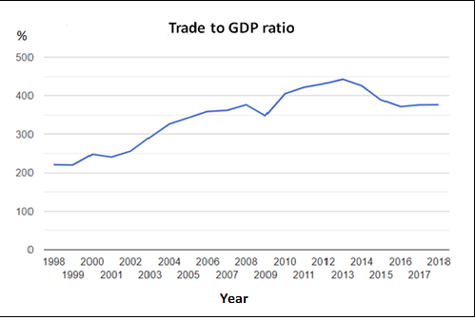
A. Open and externally oriented economy
Hong Kong economy is externally oriented. According to the Basic Law, Hong Kong shall pursue the policy of free trade and safeguard the free movement of goods, intangible assets and capital.
Refer to the figure below, Hong Kong’s total trade value (value of exports + value of imports) were more than two times of the GDP in the past 20 years.
Source：TheGlobalEconomy.com, The World Bank

Slide 7
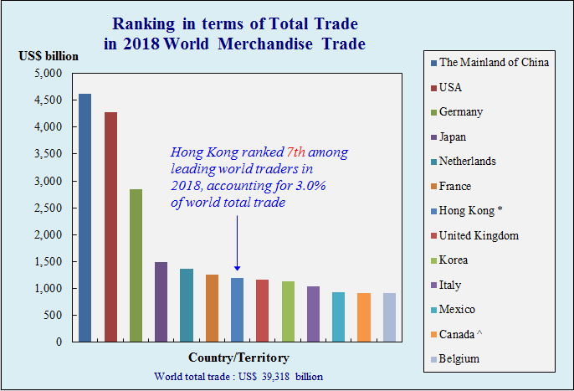
A. Open and externally oriented economy
Hong Kong was the world's 7th largest trading entity in goods in 2018
Source：Trade and Industry Department

Slide 8
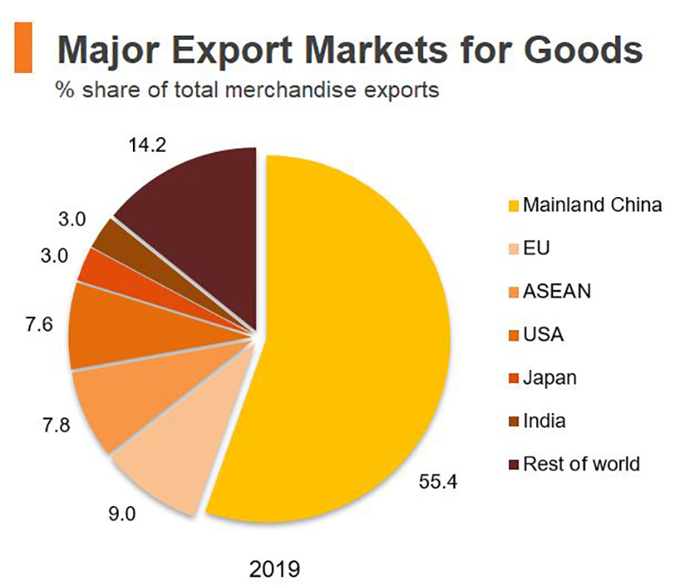
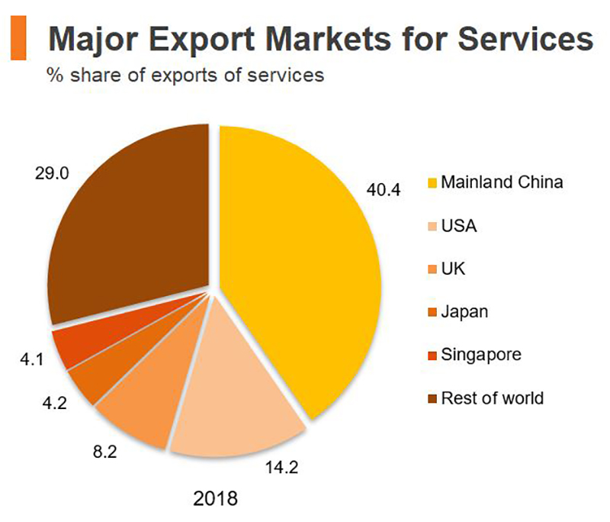
B. Close economic relations with the world (especially the Mainland)
The Mainland is the major market for Hong Kong’s merchandise and service exports
Source ：Hong Kong Trade Development Council

Slide 9
B. Close economic relations with the world (especially the Mainland)
The Mainland is Hong Kong’s major import supplier
Source：Trade and Industry Department

Slide 10
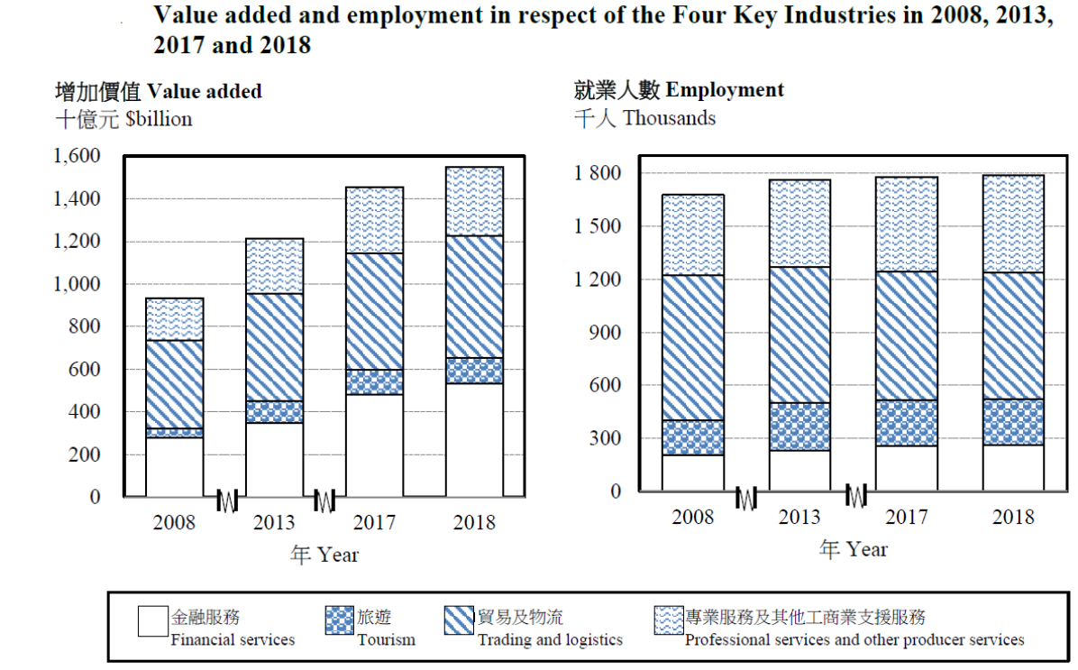
C. The Four Key Industries in the Hong Kong Economy
From the value added to GDP and employment figures, we can see the importance of financial services, trade and logistics, tourism and professional and producer services to the Hong Kong economy.
Source：Hong Kong Census and Statistics Department

Slide 11
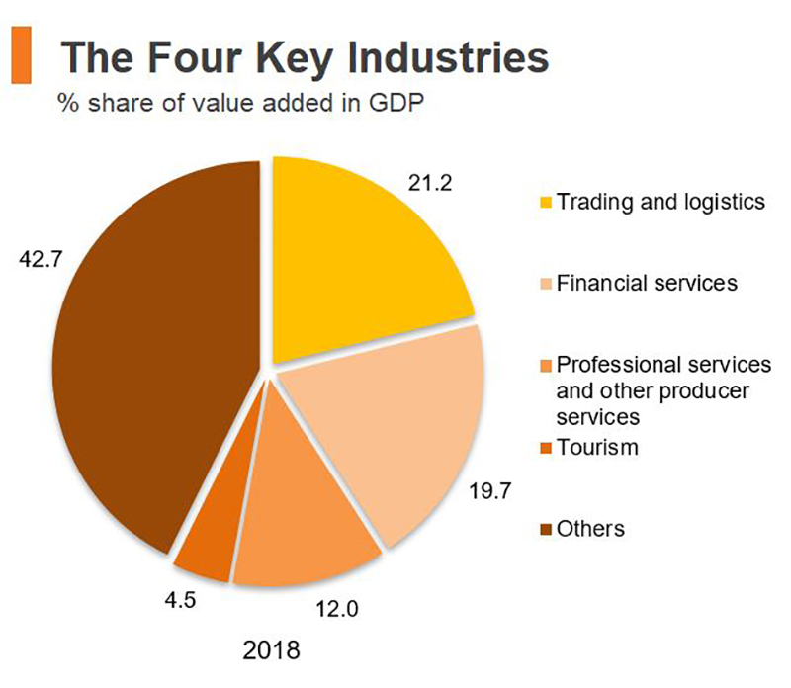
C. The Four Key Industries in the Hong Kong Economy
In 2018, financial services, trade and logistics, tourism and professional and producer services accounted for nearly 60% of Hong Kong’s GDP (estimated by value added) and nearly 50% of the total employed population.
The Four Key Industries
2018
Source：Hong Kong Trade Development Council
Source：Hong Kong Census and Statistics Department

Slide 12
II. What happened in the world under the epidemic?
The following are some information about the epidemic:
Source 1: Entry and Exit Administration of the People’s Republic of China announced that it will temporarily suspend the acceptance of approvals for the issuance of endorsements for mainland residents visiting Hong Kong and Macao. (2 Feb 2020)
Source 2: The Chief Executive announced that to reduce the flow of people, four control points including Lo Wu, Lok Ma Chau Spur Line, Lok Ma Chau and Macau Ferry Terminal will be suspended from 0:00 a.m. tomorrow.(4 Feb 2020)
Source 3: The Education Bureau decided that classes of all schools will continue to be suspended, with classes to be resumed on 20 April. The exact date of class resumption is subject to further assessment. (25 Feb 2020)
Source 4: With effect from 0.00 a.m. on March 25, all non-Hong Kong residents coming from overseas countries and regions by plane will be denied entry to Hong Kong (tentatively for 14 days). (23 Mar 2020)
Source 5:

Slide 13
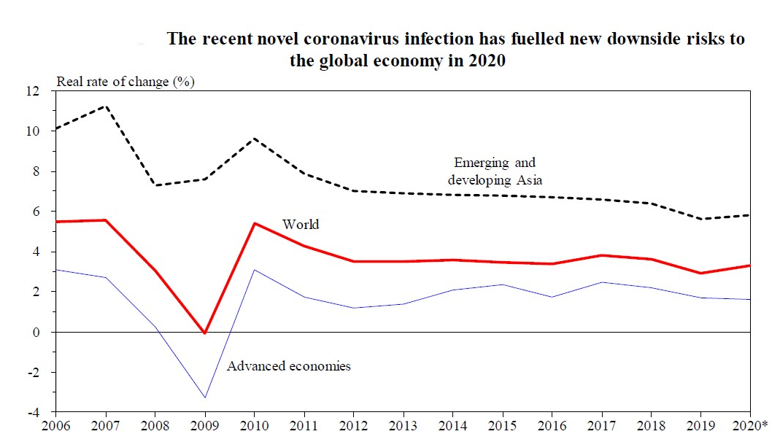
II. What happened in the world under the epidemic?
Source 6: Under the pandemics of COVID-19, the global economic outlook is gloomy
Note: (*) Forecasts from the IMF
Source ：2019 Economic Background and 2020 Prospects（Financial Secretary’s Office）

Slide 14
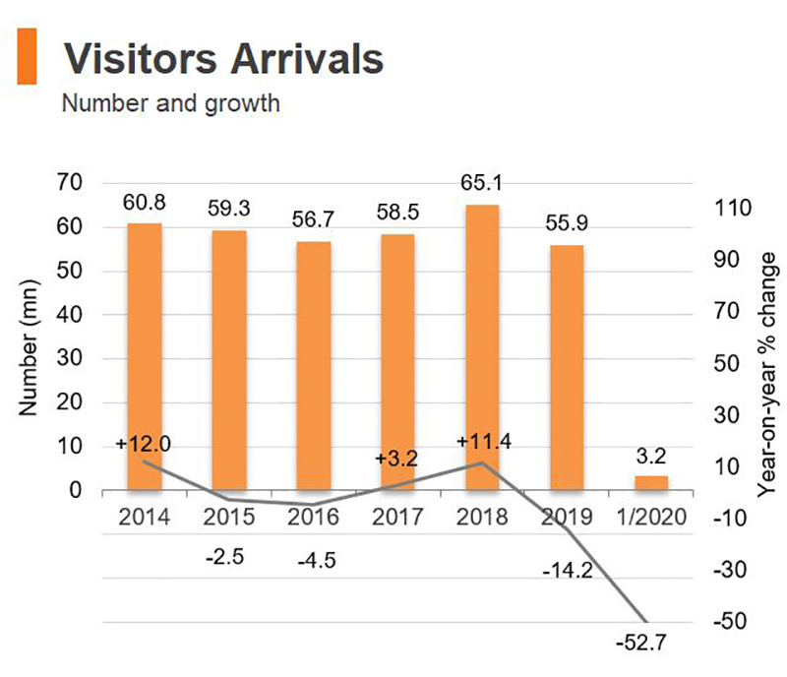
III. Impacts on Hong Kong economy? Any supporting data?
Source 1, 2 & 4→The number of visitors from the Mainland and other places reduced
Tips for reading diagram:
In the diagram, the horizontal axis indicates the cumulative annual data from years 2014 to 2019; while only the data of January 2020 is indicated; hence, when comprehending the data concerned, it is important for us to pay attention to the unit of the data (e.g. in terms of years or month).
Latest data:
About 199,000 visitors arrived Hong Kong in Feb 2020. There was a 96.4% decrease compared to Feb 2019.
Source: Census and Statistics Department
Source：Hong Kong Trade Development Council

Slide 15
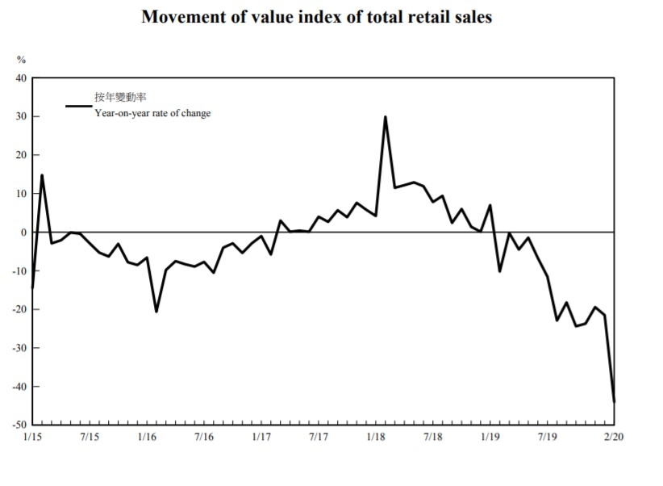
III. Impacts on Hong Kong economy? Any supporting data?
Sources 3 & 5 → school suspension, reduction of social life→ Decrease in citizens’ expenditure on transports, dining and shopping
Source：
Census and Statistics Department
（Remarks: The retail sales statistics only reflect the sales receipts in respect of goods sold by local retail establishments, they do not cover the revenue of restaurants that provide catering services and other affected industries.）

Slide 16
III. Impacts on Hong Kong economy? Any supporting data?
Press release: Volume and price statistics of external merchandise trade in
February 2020
＊＊＊＊＊＊＊＊＊＊＊＊＊＊＊＊
The Census and Statistics Department released today (April 16) the volume and price statistics of external merchandise trade for that month.
As the trade flows in January and February of each year tend to show considerable volatilities due to differences in timing of the Lunar New Year holidays, it is useful to analyse the trade figures for these two months taken together. Comparing the first two months of 2020 with the same period in 2019, the volume of Hong Kong’s total exports of goods and imports of goods decreased by 11.8% and 9.1% respectively.
In February 2020, the volume of Hong Kong's total exports of goods and imports of goods increased by 5.4% and 0.9% respectively over February 2019.
Comparing the three-month period ending February 2020 with the preceding three months on a seasonally adjusted basis, the volume of total exports of goods and imports of goods decreased by 7.5% and 5.4% respectively.
Source：Census and Statistics Department

Slide 17
III. Impacts on Hong Kong Economy? Which economic indicators can reflect the situation?
In the Economics Curriculum, we have learnt the following three major economic performance indicators:
Gross domestic product (GDP)：the total value of production of all resident producing units of a country or region in a specified period (typically a year or a quarter).
Unemployment rate：the proportion of unemployed persons in the labour force.
$Unemployment Rate=\frac{Unemployed population}{labour force}×100\%$
Inflation rate: the rate of change of general price index measured by the implicit price deflator of GDP or Consumer Price Index.
**We will analyze the first two indicators in this PowerPoint.

Slide 18
III. Impacts on Hong Kong economy? Gross Domestic Product
GDP = C + I + G + X – M
Sources 1, 2 & 4 →visitors from the Mainland and other places reduced →X ↓
Sources 2 & 5→ citizens’ spending on transports, dinning-out and shopping →C ↓
Source 6 → gloomy prospect →investment incentive reduces →I ↓
The impacts of epidemics on I, G, X, M ➔ Effects on GDP?

Slide 19
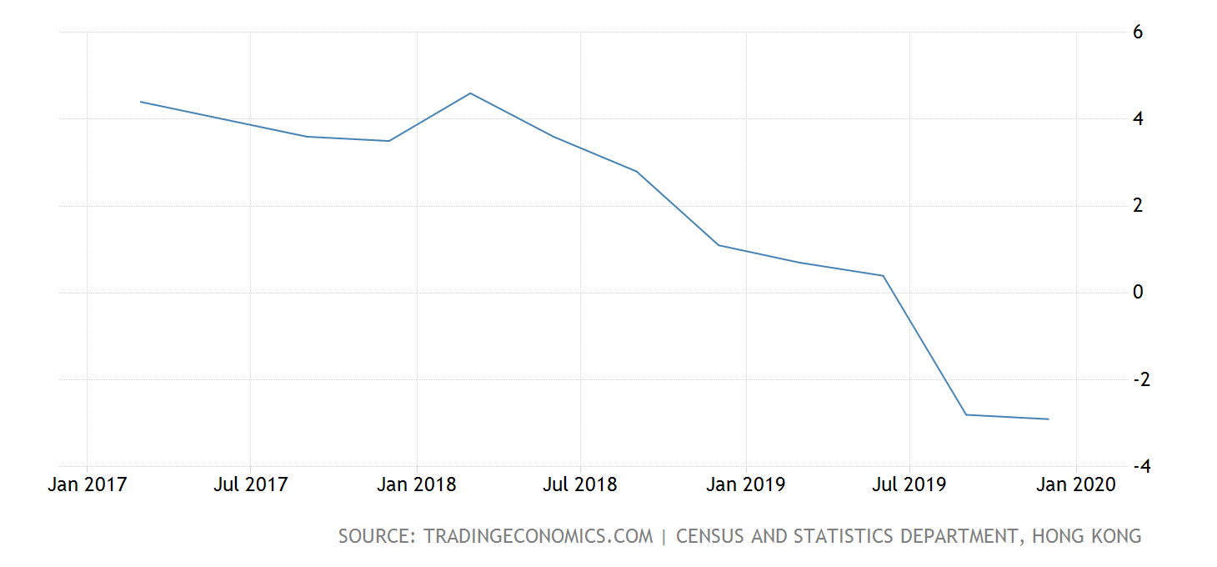
III. Impacts on Hong Kong economy? Gross Domestic Product
GDP (year-on-year percentage change in real terms) (%)
Remark: The figure does not reflect the impacts of epidemics on the economy from
January 2020 onwards

Slide 20
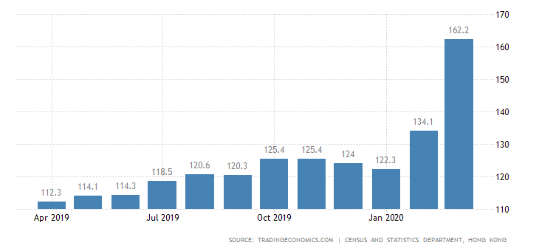
III. Impacts on Hong Kong economy? Labour Market
Unemployed Population (‘000)

Slide 21
III. Impacts on Hong Kong economy? Labour Market
Source：Census and Statistics Department

Slide 22
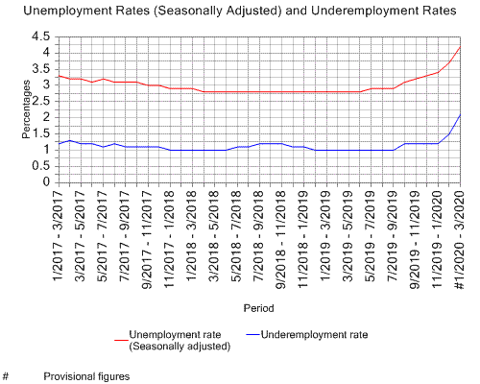
III. Impacts on Hong Kong economy? Labour Market
Source：Census and Statistics Department

Slide 23
III. Impacts on Hong Kong economy? Labour Market
Which industries would be affected by the reduction of visitors?
“The employment situation of the consumption- and tourism-related sectors (viz. retail, accommodation and food services sectors) exacerbated further, as the threat of the COVID-19 infection has brought inbound tourism to a standstill and dealt a severe blow to consumption-related activities. The unemployment rate and the underemployment rate of these sectors combined surged to 6.1% and 2.5% respectively, both the highest in about a decade. The situation in food and beverage service activities was particularly severe, with the unemployment rate and the underemployment rate soaring to 7.5% and 3.5% respectively. Meanwhile, the unemployment and underemployment situation in the construction sector deteriorated drastically, as construction activities saw visible slowdown. The underemployment rate of the transportation sector also rose noticeably amid sharply reduced people and cargo flows.”
Source：Census and Statistics Department

Slide 24
III. Impacts on Hong Kong economy? Labour Market
Think about it：When the unemployment rate increases, does the unemployed population necessarily increase?
Ans: Not necessarily
$Unemployment Rate=\frac{Unemployed population}{labour force}×100\%$
If some people lose their jobs and they choose to leave the labour force, this will lead to a situation that the unemployment rate increases with no change in the unemployed population.

Slide 25
III. Impacts on Hong Kong economy? Labour Market
Extended enquiry: Which group of people (Male or female? Which age group?) are more likely to leave the labour force when they lose their jobs? To answer this question, what kinds of reference do we need?

Slide 26
III. Impacts on Hong Kong economy? Analysis with economic model
Aggregate supply-aggregate demand model
GDP = C + I + G + X – M
For simplicity, we assume the long run aggregate supply is not affected by the epidemic
When C, I, X decrease→ Aggregate demand will decrease
When workers and factories suspend working due to the epidemic→ short run aggregate supply will fall
Price level
LRAS
SRAS2
SRAS1
AD1
AD2
0
Y2
Y1
Output

Slide 27
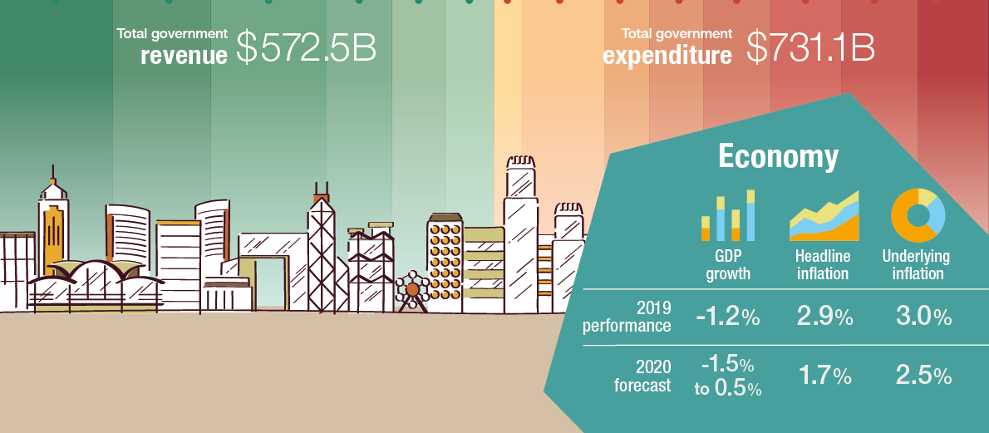
How does the Hong Kong government respond to economic difficulties through fiscal policy?
What is the nature of this budget? How can we know?
Deficit budget:
→estimated expenditure > estimated revenue
→expansionary fiscal policy → stimulate the economy through counter-cyclical measures

Slide 28
How does the Hong Kong government respond to economic difficulties through fiscal policy?
Which component(s) of GDP is/are affected by the following measures?

Slide 29
How does the Hong Kong government respond to economic difficulties through fiscal policy?
Which component(s) of GDP is/are affected by the following measures?

Slide 30
How does the Hong Kong government respond to economic difficulties through fiscal policy?
Which component(s) of GDP is/are affected by the following measures?

Slide 31
How does the Hong Kong government respond to economic difficulties through fiscal policy?
GDP = C + I + G + X – M
For simplicity, we assume the long run aggregate supply is not affected by the epidemic
The government stimulates C, I & G through expansionary fiscal policy→ AD increases
Think about it: Would the above measures affect SRAS?
Price level
LRAS
SRAS2
SRAS1
AD1
AD2
0
Y2
Y1
Output

Slide 32
Impacts of epidemic on the economy: extended enquiry
How did the consumption pattern of citizens change during epidemic? Which industry/industries would be positively affected?
Ans.：Citizens reduced shopping and dining out during the epidemics but increased their spending on online-shopping and take-away food, the related industries may hence have growth in business.
During this period, the news often reported store closures and layoffs, but why did the unemployment rate not reflect these phenomena?
Ans.：Some economic indicators (such as unemployment rate) are lagging indicators, which will be updated and reflect market conditions after some time has passed.

Slide 33
Latest News: A series of supporting measures (updated on April 15, 2020)
The booklet introduces a package of support measures under the first round of Anti-Epidemic Fund (AEF), the 2020-21 Budget and the second round of AEF.
Weblink：
https://www.coronavirus.gov.hk/pdf/fund/CE-Measure-12-eng.pdf

Slide 34
Part II：Microeconomics
Demand and supply analysis of masks
Externality of epidemic

Slide 35
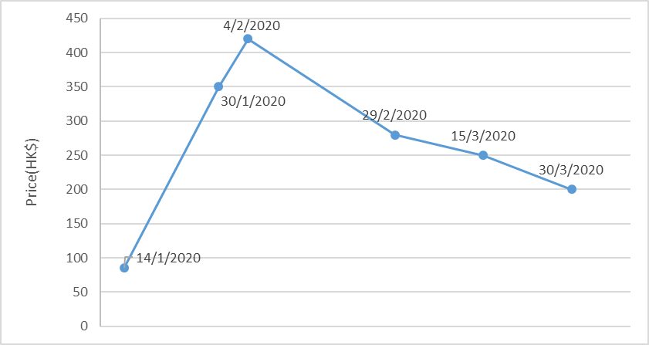
Demand and Supply Analysis of masks
Refer to the following information and answer the questions：
50 pieces
Source 1: The following figure shows the trend of price of a box of basic surgical mask

Slide 36
Demand and Supply Analysis of masks
Source 2: The following table lists out the events related to COVID-19 during Jan to Mar 2020.
Time | Events
Phase 1 : 2020/01/14- 2020/01/23 | Masks have been snapped up in Wuhan, Guangdong, Sichuan, Guangxi, etc. Masks are out of stock and prices are rising in many local pharmacy. COVID-19 has spread rapidly throughout the country. Wuhan has implemented control of outbound personnel and canceled outbound tour groups. All personnel of the organization shall not leave Wuhan.
Phase 2 : 2020/01/23- 2020/02/07 | COVID-19 is rapidly spreading in many provinces and cities in the Mainland. Hong Kong citizens have started to buy masks. HK General Chamber of Pharmacy Limited has pointed out that more than half of the pharmacies in Hong Kong are faced with the problem of masks being out of stock. Due to the time of the Lunar New Year, it is expected that masks in the market will not be available until the tenth day of the lunar year, and hence they started to import masks from Southeast Asia. The government announced the closure of the four ports of Lo Wu, Lok Ma Chau, Huanggang and the Hong Kong-Macau Ferry Terminal, leaving only the airport, Hong Kong-Zhuhai-Macao Bridge and Shenzhen Bay to reduce the flow of people.

Slide 37
Demand and Supply Analysis of masks
Source 2: The following table lists out the events related to COVID-19 during Jan. to Mar. 2020 (Cont.)
Time | Events
Phase 3 : 2020/02/07- 2020/03/13 | Due to the recent increase in supply of masks and lower wholesale prices from different regions, pharmacies in various districts have reduced prices in order to sell the masks. In addition, local mask factories are about to be put into production. The government spent $1.5 billion to provide a maximum of $2-3 million for each production line of each local mask factory, and pledged to purchase up to 24 million masks from each production line within a year at a price of $3.
Phase 4 : 2020/03/13- 2020/03/31 | More than 10 local mask production plants have been put into production one after another and some have already pre-sold the masks online. They produce masks with different levels of disease prevention to choose. Basic masks cost about HK$2 to HK$4 each. The epidemic situation in the mainland has gradually eased, and the demand for masks has decreased. In addition, many places have also resumed work, and the supply of masks has gradually increased.

Slide 38
Demand and Supply Analysis of masks
Think about it (1)：Use a supply and demand diagram to explain why at the beginning of the outbreaks, the price of masks soared several times in a short period of time. (Hint: What is the price elasticity of supply of masks?)

Slide 39
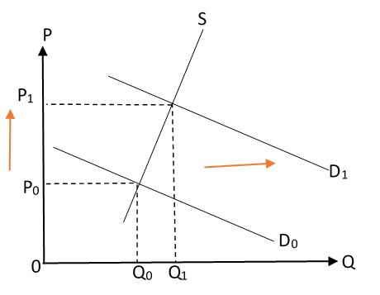
Demand and Supply Analysis of masks
Answer
According to Source 2, in the early stage of the epidemic, the demand for masks increased sharply. However, due to the shortage of masks produced in the Mainland (the Mainland accounted for a large share of the global mask supply), plus the difficulty of local production of masks in a short time, the price elasticity of supply of masks is quite low, so as shown in Source 1, the price of masks increased significantly at the beginning of the outbreak.
Market of masks

Slide 40
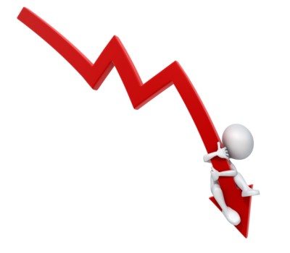
Demand and Supply Analysis of masks
Think about it (2)：Use a supply and demand diagram to explain why the price of masks has a downward trend after February.

Slide 41
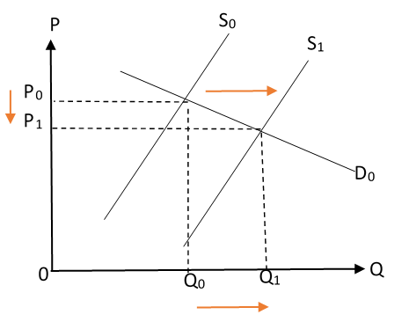
Demand and Supply Analysis of masks
Answer
According to Source 2, the supply of masks from different regions in the market increased in mid-February. In addition, several local mask manufacturers have been put into production, and the mask production in the Mainland has gradually resumed. Hence the supply of masks in the market increased. Therefore, as Source 1 shows, the price of masks began to decline after February.
Market of masks

Slide 42
The externality of the epidemic
Refer to the following three news excerpts and answer the questions
Source (1)--Some local mask manufactures said that the shortage of masks in Hong Kong caused much inconvenience to people; and the prices of imported masks are too high for ordinary citizens to afford. Therefore, they actively looked for raw materials, machines and factories to produce quality masks. (8 Feb 2020)
Source (2)--Because of the shortage of masks in Hong Kong, the government applied to the Finance Committee of the Legislative Council for an appropriation of HK$30 billion for the “Anti-epidemic Fund”, of which HK$1.5 billion was reserved to support local mask production. (26 Feb 2020)
Source (3)--The Commerce & Economic Development Bureau today announced that it has approved 5 applications with 6 production lines under the Local Mask Production Subsidy Scheme. The subsidy involves HK$12.5 million at maximum. It is expected that the production will be put into operation in April and May. On average a total of 10 million masks per month can be produced for government use, and one production line produces an average of 20,000 masks per month for the local market. (27 Mar 2020)

Slide 43
The externality of the epidemic
Think about it：From the perspective of externality, analyze the rationale for government subsidies for local mask production.

Slide 44
The externality of the epidemic
Answer：
Wearing a mask during the epidemic, while protecting yourself, will also reduce the chance of others being infected. Since the person wearing the mask does not receive compensation from others (those with a reduced chance of being infected), there are external benefits. The marginal social benefit of wearing a mask is higher than the marginal social cost.
However, during the epidemic, the supply of masks in the market was quite tight. Therefore, producing masks for people to wear during the epidemic had higher marginal social benefits than marginal social costs, and external benefits also appeared. Under the principle of maximization, the mask manufacturers will only produce at the level where the marginal private benefits equal the marginal private costs, and it is below the efficient level. With government subsidies, the marginal private benefits of mask manufacturers will increase, they will hence increase the production of masks, thereby narrowing the gap between the marginal social benefits and the marginal social costs.

Slide 45
[For teachers’ reference]：Beyond theoretical knowledge, the extended question about local mask production
Refer to the sharing of local mask manufacturers in Source (1), guide students to think about what they can learn from them.
Answer for reference: The manufacturers possess entrepreneurial spirit which includes the qualities of possessing creativity and innovativeness, taking initiatives and responsibilities, taking calculated risks, upholding perseverance in times of uncertainty and seizing the best of the opportunities ahead.

Slide 46
[Values education]：The externality of the epidemic -- We can also contribute
Apart from the government, what actions can we take as a member of society to reduce externality of the epidemic?
Watch the following video and suggest some feasible methods：
Video(1) (Chinese version only)
https://www.youtube.com/watch?v=yGJ3gXRFeKs
Care about people in need in society (such as the elderly and the disabled), for example, to share with them epidemic prevention resources to reduce their chances of being infected.
Video (2) (Chinese version only)
https://www.youtube.com/watch?v=GMx0rGQGaAY&list=PL1188A9802575C33F&index=16
Maintain personal hygiene and reduce social contact to reduce the chance of infection.

Slide 47
[Values education]： Epidemic and Income inequality
Read an article written by Prof Tang Heiwai：“Coronavirus could leave the world an even more unequal place. That would be a real disaster” Think about the impact of the epidemic on income inequality and help those in need in society.
Extended reading：Book from 2019 Nobel Economics Prize Laureate
Source：Hong Kong Public Library

Slide 48
[Values education]：How to avoid being misled by “fake news”?
Read the article “How to read the news like a scientist and avoid the COVID-19 ‘infodemic’” from World Economic Forum and think about the following questions：
How does the widespread of “fake news” adversely affect the economy?
How to avoid being misled by “fake news”?
Extended enquiry：Should the government regulate “fake news”?
Points for reference :
“Fake news” may contain incorrect information that could disturb the demand and supply in the market, causing price fluctuation that affect the signaling function of price.
Would the cost of using market to reduce the negative impacts caused by “fake news” higher or lower than that of government intervention?

Slide 49
Article Recommendation
“The novel coronavirus and economic contagion” by Professor Chong Tai-leung, 15 February 2020
https://www.eastasiaforum.org/2020/02/15/the-novel-coronavirus-and-economic-contagion/?from=timeline&isappinstalled=0
“COVID-19 & Monetary Policy” by Professor Luk Yim-fai, 4 March 2020
https://www.fbe.hku.hk/in-the-media/covid-19-and-monetary-policy

Slide 50
Book Recommendation
Source：Hong Kong Public Library

Slide 51
Book Recommendation
Source：Hong Kong Public Library

Slide 52
Book Recommendation
Source：Hong Kong Public Library

Slide 53
Book Recommendation
Source：Hong Kong Public Library

Slide 54
Book Recommendation
Source：Hong Kong Public Library

Slide 55
Reference
Hong Kong Economy
https://www.hkeconomy.gov.hk/en/situation/index.htm
Census and Statistics Department, HKSAR
https://www.censtatd.gov.hk/home/index.jsp
Trade and Industry Department
https://www.tid.gov.hk/eindex.html
Hong Kong Public Library
https://www.hkpl.gov.hk/en/index.html
Hong Kong Trade Development Council
https://research.hktdc.com/en/data-and-profiles/market-profiles/hong-kong

